Slide 1
Configuration Management 1
SE489: DevOps Engineering

Slide 2
Outline
What is Configuration Management?
Before and After Configuration Management
Configuration Management Tools
What is Ansible?
Ansible Features
Ansible Case Study
Ansible for Orchestration, Provisioning, CM, AD, and Security

Slide 3
What is Configuration Management?

Slide 4
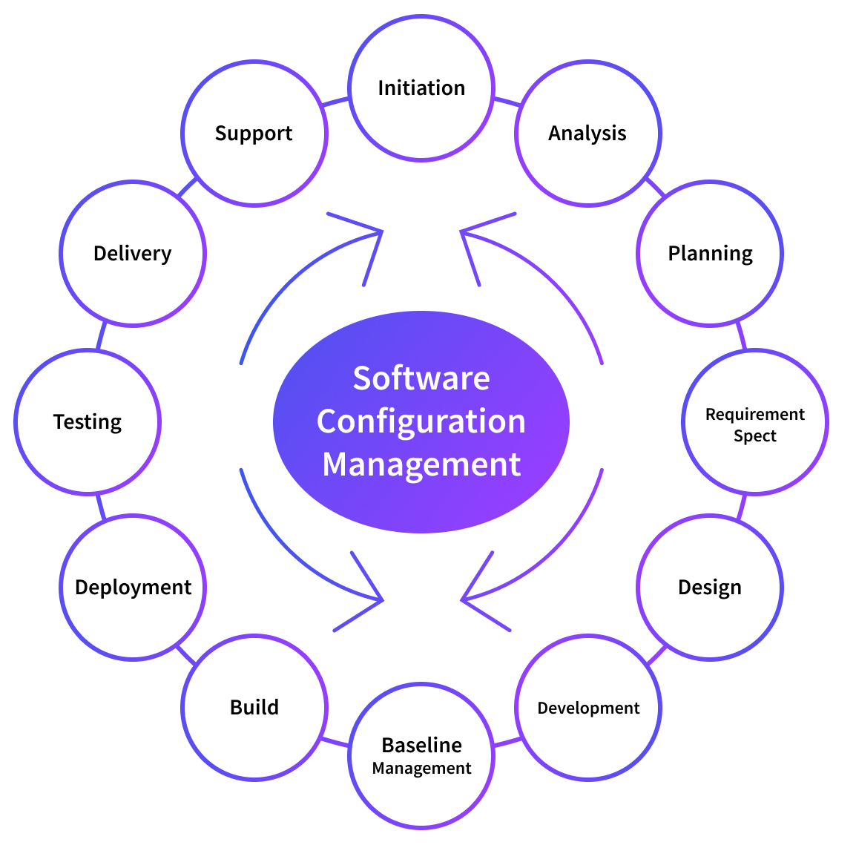
Configuration Management

Slide 5
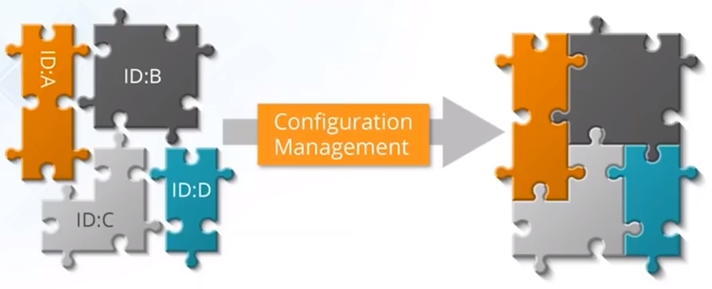
Configuration Management
Establish and maintain consistency of product performance
Maintain physical attributes with its requirements and design
Preserve operation information throughout its life

Slide 6
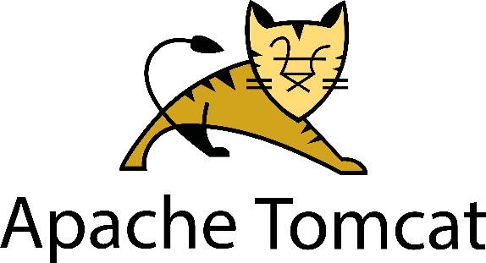
Configuration Management
Configuration management (CM) manages changes in the system or the server runtime environment.
Let's consider an example where we need to manage multiple servers with the same kind of configuration.
For example, we need to install Tomcat on each server.
What if we need to change the port on all servers, update some packages, or provide rights to some users?
Any kind of modification in this scenario is a manual and, if so, error-prone process.
As the same configuration is being used for all the servers, automation can be useful here.

Slide 7
Configuration Management
Configuration management is important in DevOps because
It helps you automate otherwise tedious tasks and allows an organization to increase agility.
It DevOps holistically, and it’s widely agreed upon that configuration management is essential to DevOps, as opposed to being just another component of the process.

Slide 8
Before and After Configuration Management

Slide 9



Before and After Configuration Management
Before
Problems in managing multiple servers
Application
Servers
After
Application
Application
Web Servers
DB Servers
App Servers
Servers
Servers

Slide 10

Before and After Configuration Management
Before
Scaling up of manual systems was a very tedious task
+
After
+

Slide 11



Before and After Configuration Management
Before
Code
Deploy
The work velocity of developers were affected since sysadmins were taking time to configure servers
Test Server
Prod Server
After
Code
Deploy
Code
Deploy
Test Server
Prod Server
Test Server
Prod Server

Slide 12
Before and After Configuration Management
Before
Upgrade
Rolling back was a problem since there was no tool to document the different versions of the application
Delete old version
Version 1
Version 2
Deploy new version
After
Upgrade
Upgrade
Delete old version
Delete old version
Version 1
Version 2
Version 1
Document old version
Version 2
Deploy new version
Deploy new version

Slide 13
Outcomes of Managed Configurations
Infrastructure-as-a-Code (IaaC)
IaaC in simplest terms is a code or script the automates the environment necessary for development, without manually completing all the steps necessary to build the environment.
Using the word ‘environment’ referrs to the set up of all computing resources required to create the infrastructure to perform DevOps actions. This could be servers, networks of configurations and other resources.
Configuration-as-a-Code (CaaC)
CaaC is a string of code or script that standardizes configurations within a given resource, like a server or network.
These configurations are applied during the deployment phase to ensure the configuration of the infrastructure makes sense for the application.

Slide 14
Benefits of IaaC and CaaC
These are some of the benefits of the two key outcomes:
Automation of the infrastructure environment provides standardization
Setups are free of human error
Collaboration is enhanced between operations and development
Keeps configurations from drifting
Makes infrastructure more flexible, ready to scale
Each step is consistent across all resources
Version control is a given
With these benefits applied to an organization, efficiency and greater agility are a natural result.
DevOps is practically synonymous with configuration management, IaaC, and CaaC.

Slide 15
Configuration Management Tools

Slide 16
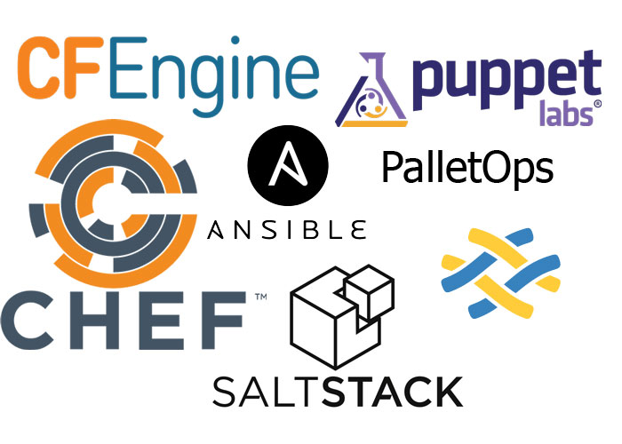
Configuration Management Tools

Slide 17
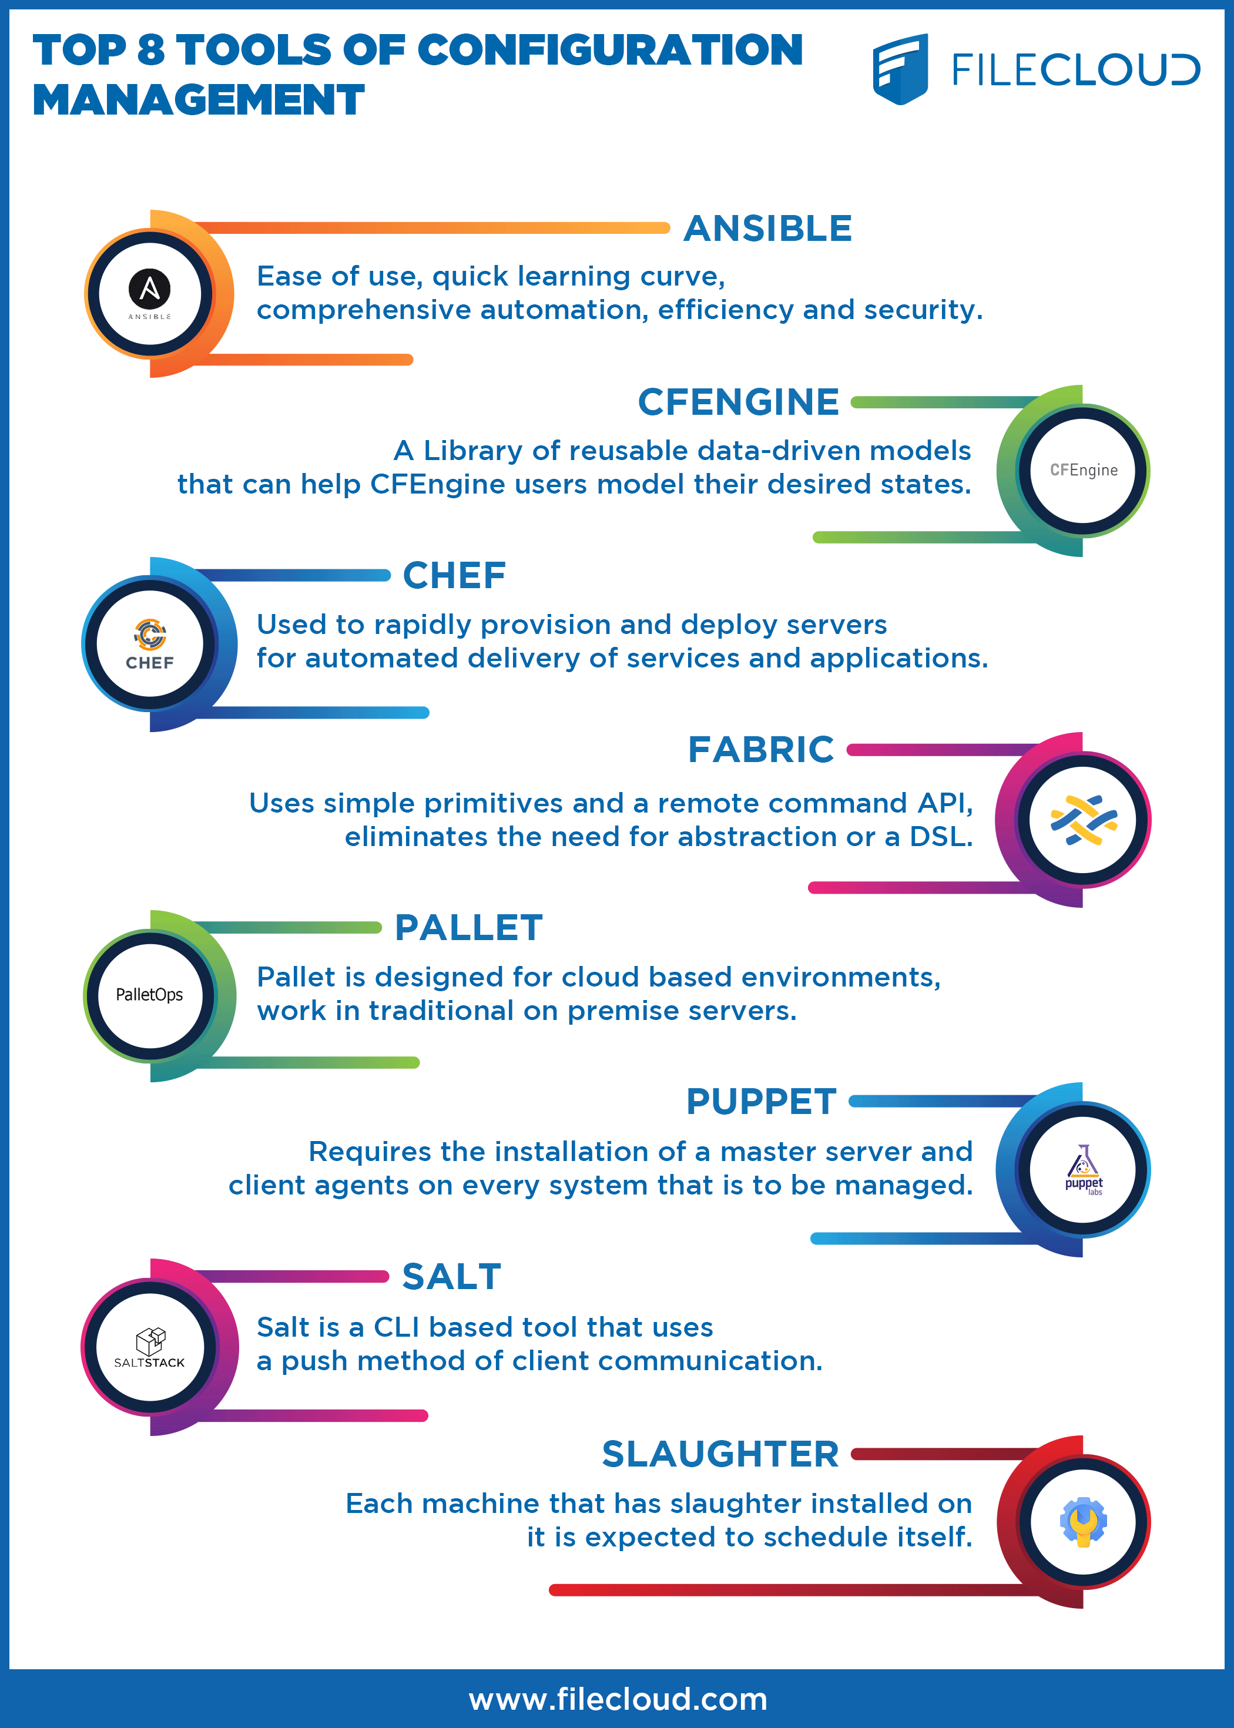

Slide 19
What is Ansible?

Slide 20
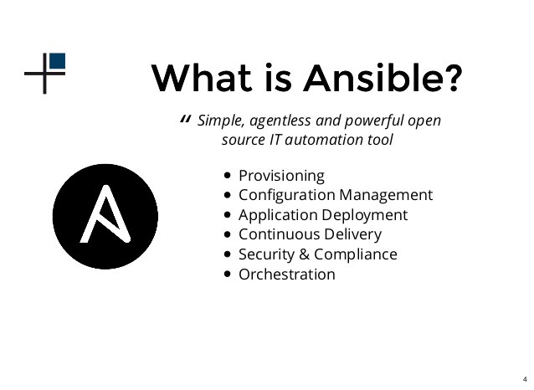
What is Ansible?

Slide 21

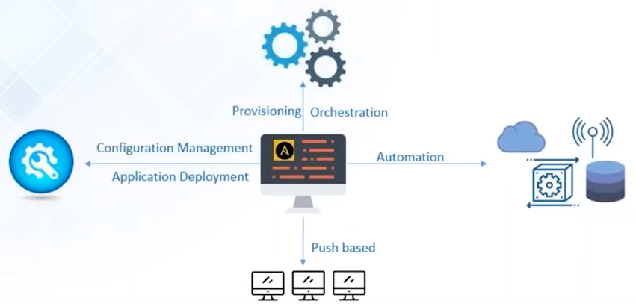
What is Ansible?
Ansible is a Configuration Management, Deployment, and Orchestration tool
It is a “push-based” Configuration Management tool
It automates your entire IT infrastructure by providing large productivity gain

Slide 22
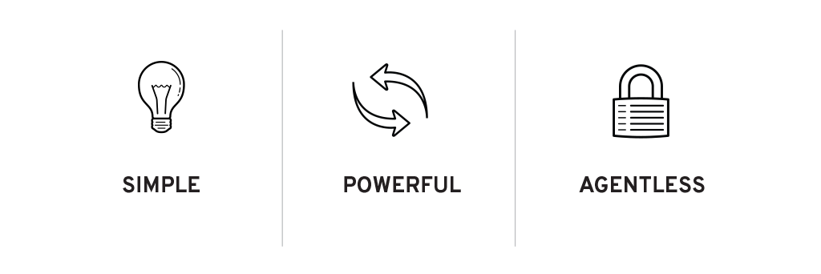
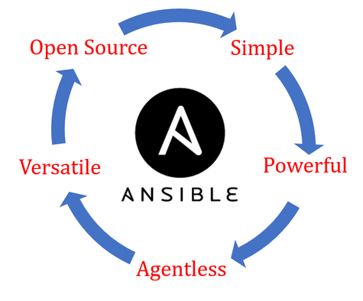

Ansible Features
Simple to install and setup and very easy to learn
No need for any agent or client software to manage nodes
Capabilities to model complex IT workflows and orchestrate your entire IT infrastructure
Extensible with modules written in any programming language
EFFICENT

Slide 23
Ansible Case Study

Slide 24
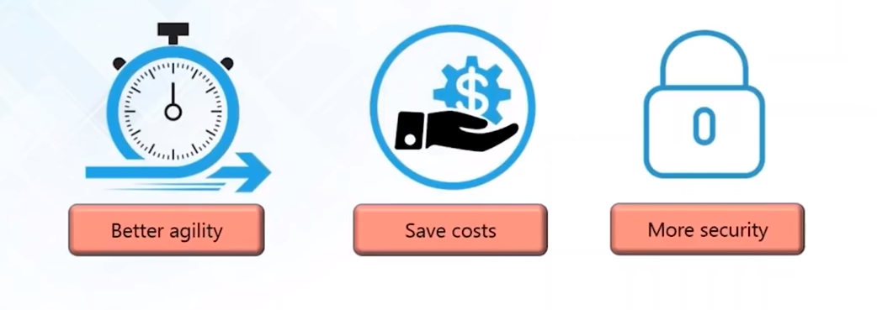

Ansible Case Study: NASA
NASA wanted to move 65 applications from traditional hardware based data centers to cloud based environment
What NASA wanted to achieve:

Slide 25
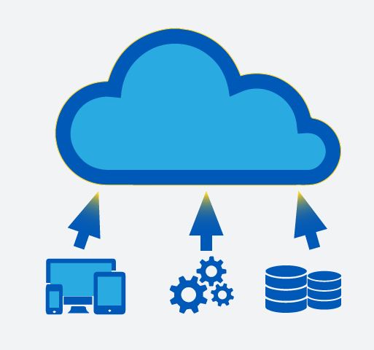
The problem …
Applications were migrated “as is” to cloud environment.
Environment spanning multiple VPCs and AWS accounts was created which couldn’t be easily managed
Managing access rights, security patching, and other simple tasks became tedious

Slide 26
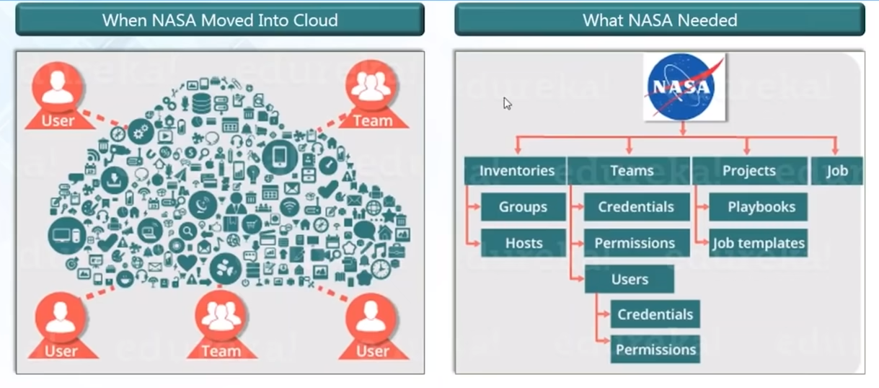
The problem …

Slide 27
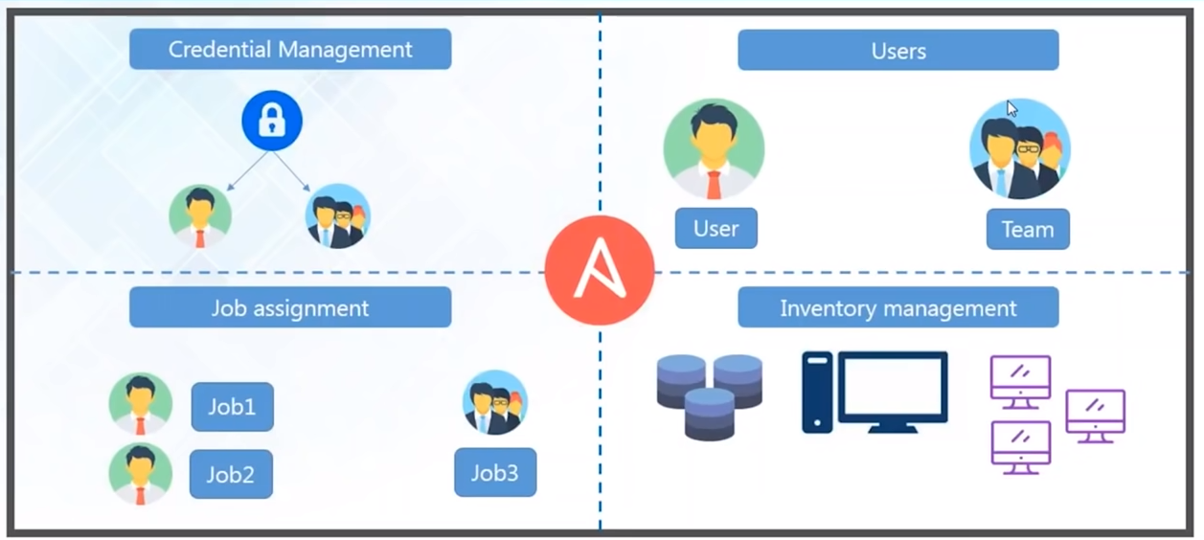
Ansible Tower to the rescue

Slide 28
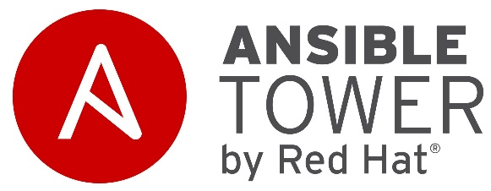
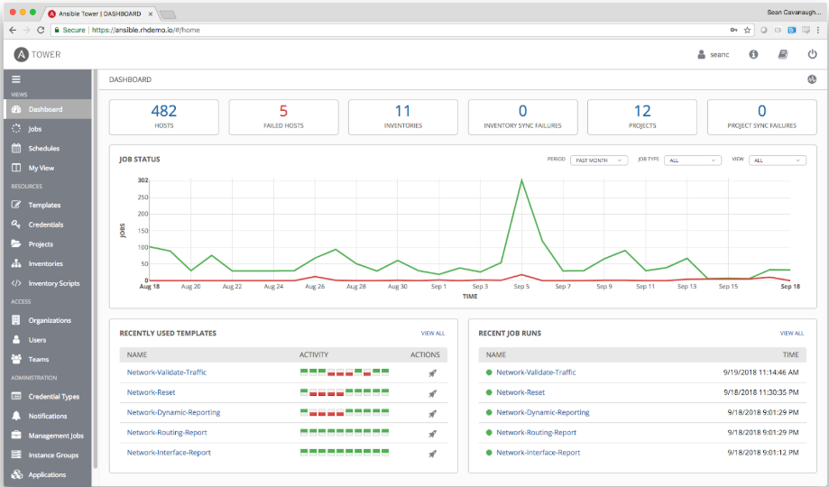
Ansible Tower Dahsboard
Provides status summary of all jobs
Divided organization into groups to manage access permissions

Slide 29
Results …
Updating nasa.gov went from 1 hour to 5 minutes
Security patching updates went from multi-day process to 45 minutes
Provisioning OS accounts across entire environment under 10 minutes
Application stacks set up time reduced from 1-2 hours to 10 minutes
Achieved near real-time RAM and disk-monitoring
Baselining standard AMIs from 1 hour manual process to invisible process

Slide 30
Ansible Architecture

Slide 31
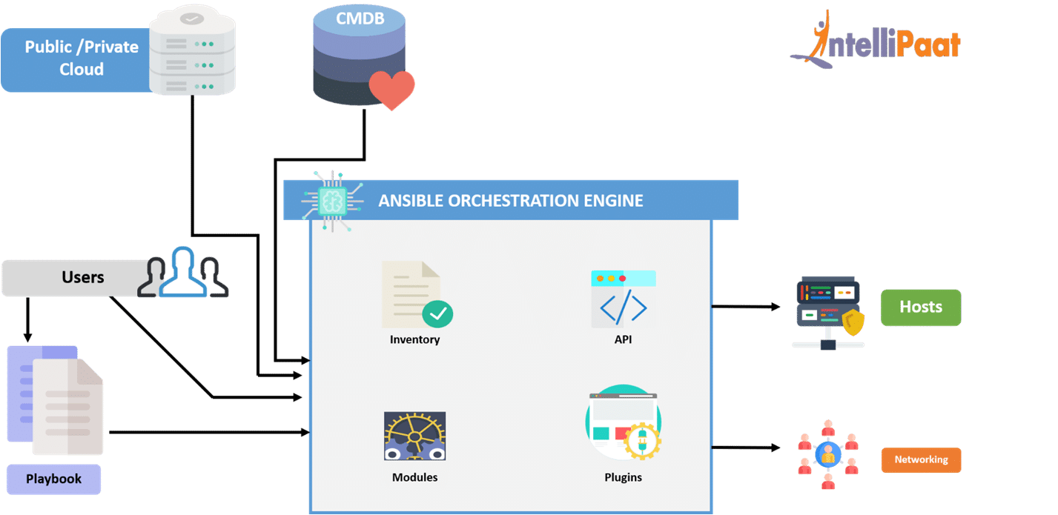
Ansible Architecture

Slide 32
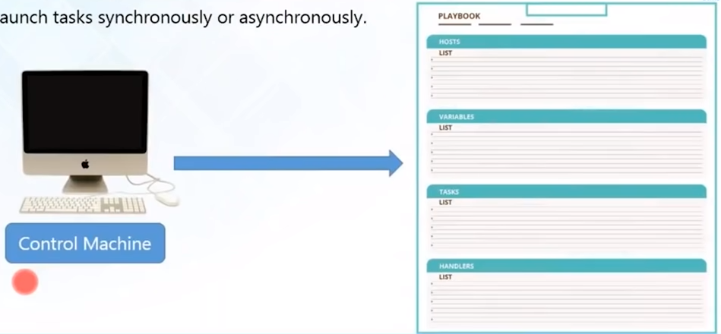
Ansible Playbook
Playbooks are simple files (YAML)
Declare configuration and orchestrate manual ordered processes
Launch tasks synchronously and a synchronously

Slide 33
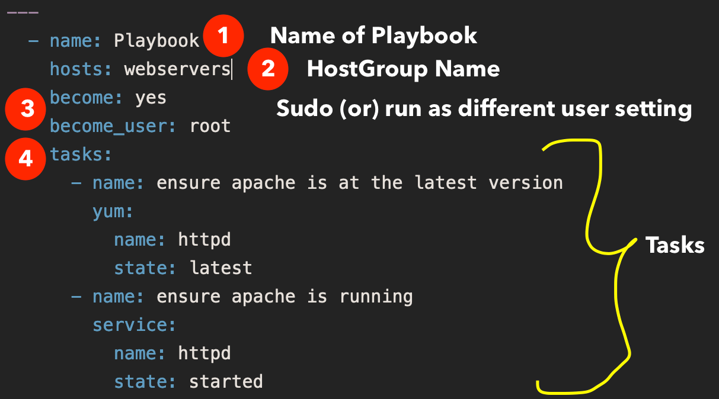
Ansible Playbook

Slide 34





How to use Ansible?
Application Deployment
Orchestration
Configuration Management
Provisioning
Security and Compliance

Slide 35
How to use Ansible?
Provision
Creation of resources. Resources can be server, files, folder, user, application etc.
Orchestration
Once the resources are created, ensuring that the same properties are applied to the newly created resources
Application Deployment
Deploy the code to the server
Configuration Management
Managing day to day activities like patching, rebooting, updating resources etc.int he specific group of servers.

Slide 36
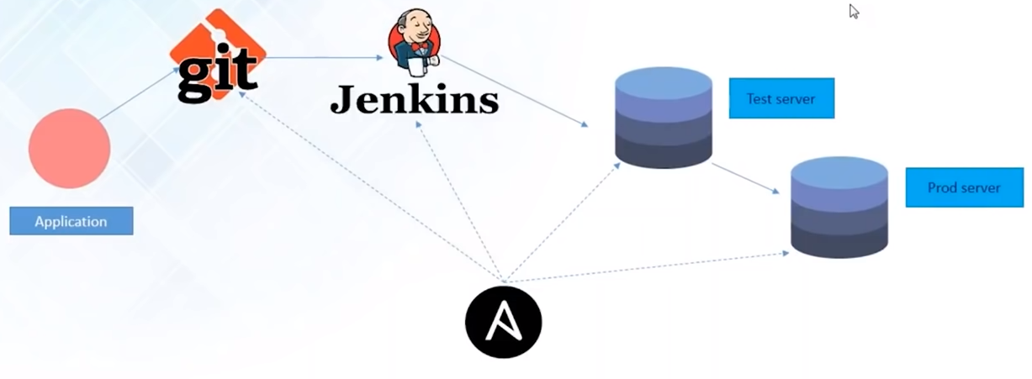
Application Deployment

Slide 37
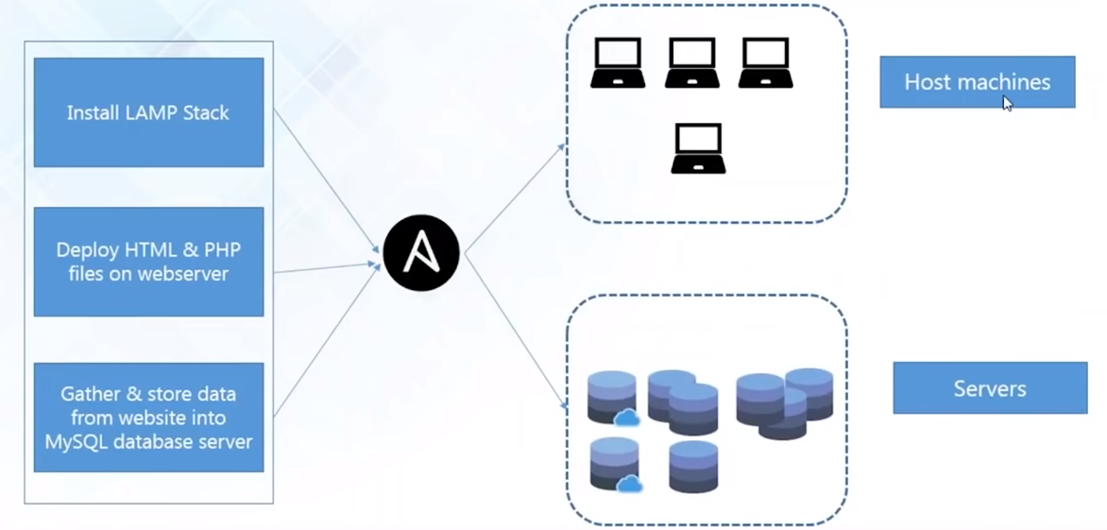
Orchestration

Slide 38
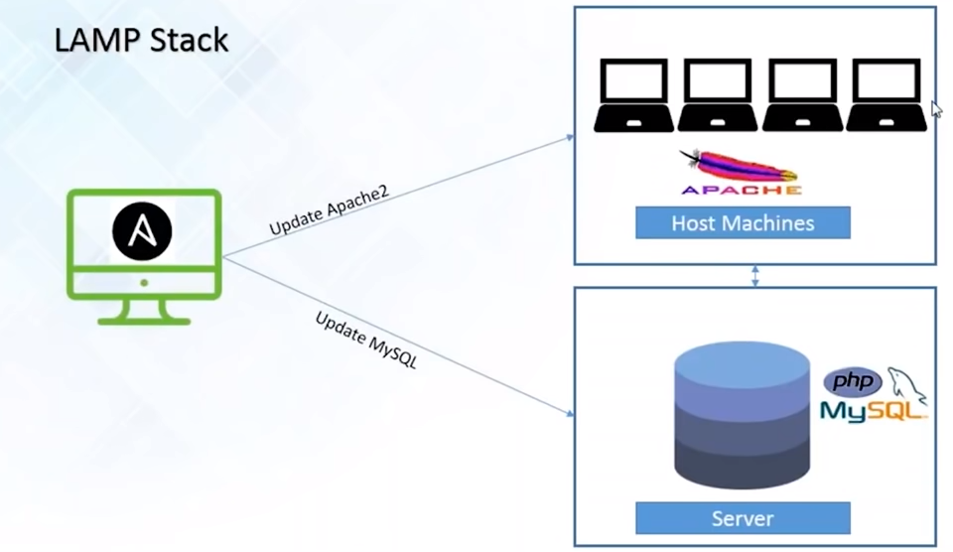
Configuration Management

Slide 39
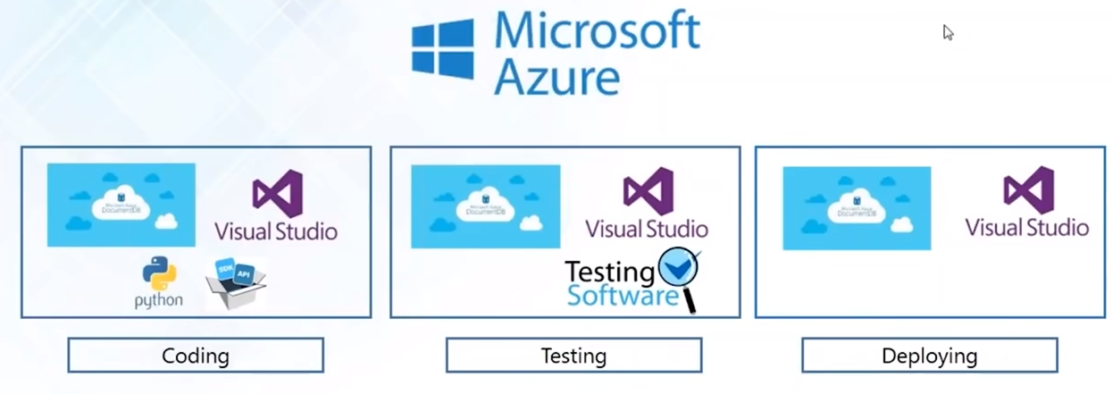
Provisioning
Provisioning of Python web application hosted on Azure

Slide 40
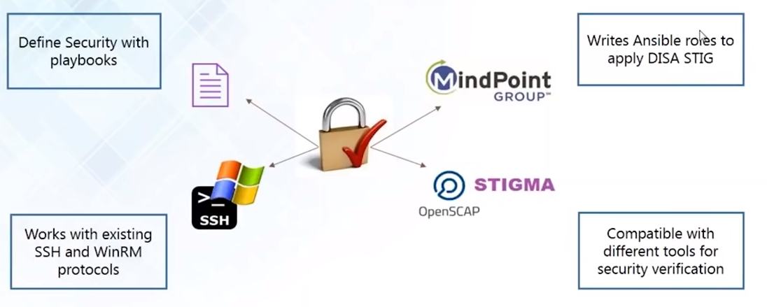
Security and Compliance

